Slide 1
wood HANDBOOK
DEFTECH
Global Limited

Slide 2
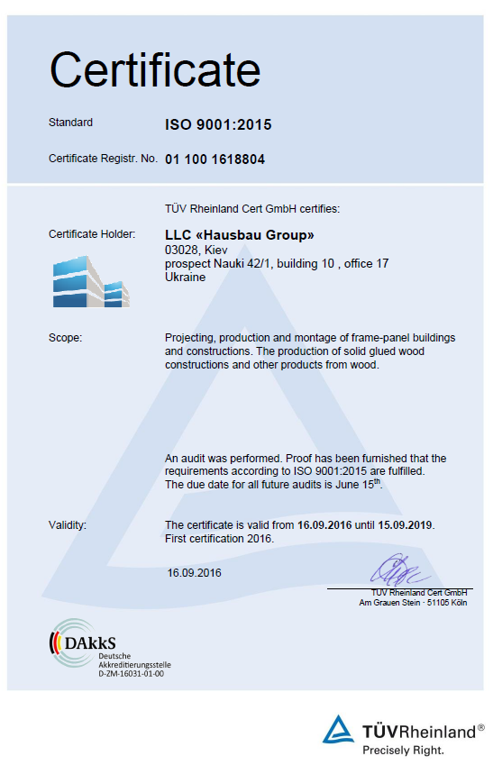
PROFILE
​​​​​​​​​​​​​​Wood as a construction material has taken on greater importance than would have been thought possible just a few years ago. Structural research has brought about major improvements to the fire safety and soundproofing of timber structures. Material developments and computer-assisted calculation and assembly methods are enabling completely new forms of design.
Deftech Global Limited in cooperating with the Ukrainian market-leading certified provider of innovative wood-based products for construction and interior usages – company «Hausbau Group», offers solutions on production and montage of frame-panel buildings and construction, production of solid glued wood construction and variety of other products and elements from wood.
The range of our products covers all areas of construction including massive ​wood elements and housing modules, wood components and building material with precisely defined characteristics, which was developed specially to meet the high requirements of modern timber construction.
Our products meet highest demands with regard to safety, quality, design and sustainability.

Slide 3
OFFICE(S) & BRANCHES
HEAD OFFICE
Administrative & corporate nature office.
Banking issues as well as legislation issues.
Holding stock of spares ready for immediate shipment on fast track basis
Office 328, Al Nokhita Building, Al Khaleej Road, Al Hamriyah Port, Dubai, U.A.E.
Tel.: +971 4 250 5341
+971 56 809 5623
Fax: +971 4 269 39 66
Registered Office
Unit 2501, Tiffany Tower, Jumeirah Lake Towers, P.O. Box 487922, Dubai, U.A.E.
REGIONAL OFFICE IN UKRAINE
Relation with the OEMs, Design Bureaus and Institutes.
2/8 Kurenivskiy provulok, Kyiv, 04073, Ukraine
Tel.: +38 066 660 8433
Fax: +38 044 251 2539
PRODUCTION FACILITIES
«Hausbau Group» LLC
03028, Kiev, Ukraine
Propspect Nauki 42/1, building 10, office 17
E-mail: a.vugman@hausbgroup.com

Slide 4
wood material

Slide 5
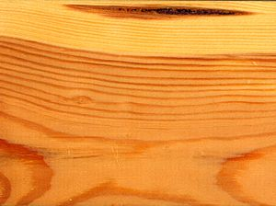
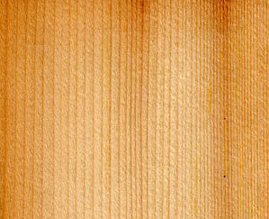
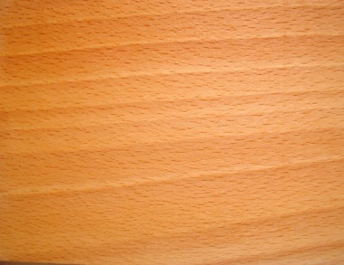
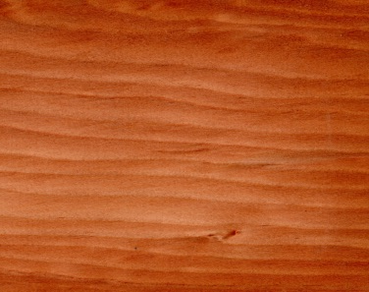
Pine-tree
Spruce
Fir
Beech
Lariks

Slide 6
wood PRODUCTS

Slide 7
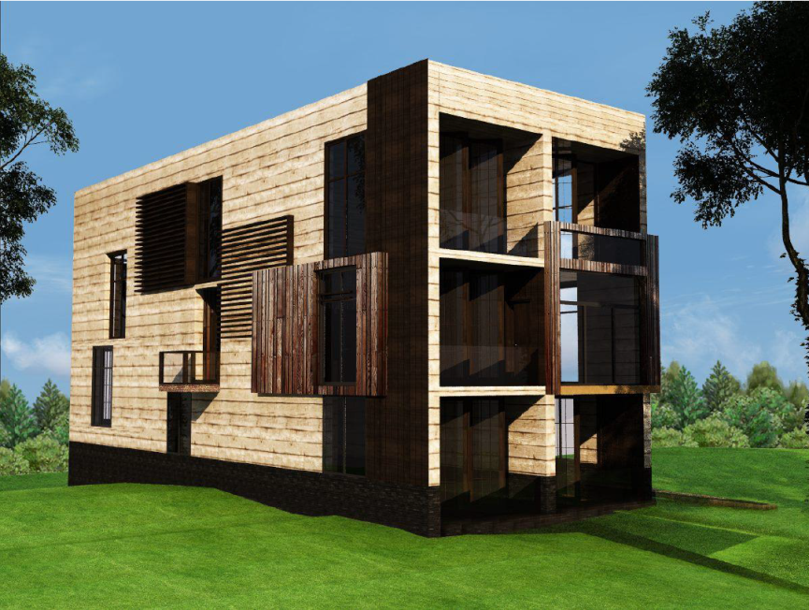
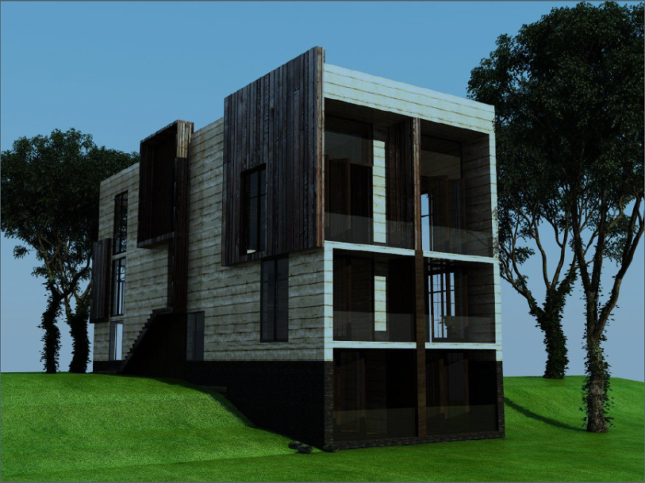
HOUSE BUILDING
Wooden houses are a more ecological and economic alternative than homes made of traditional brick and concrete. Wood is not only a part of nature, but its use is beneficial for the environment. These homes are made from natural, non-petroleum materials that are recyclable and biodegradable and are also considered 'ecological'.
The wood used in sustainable construction is certified and originate in responsible logging: the manufacturers plant new trees for each tree they fell. For them, maintaining this balance is important.
Besides, building with wood requires less energy, has a lower environmental impact and smaller carbon footprint than conventional building methods: wood absorbs CO2.
Advantages of wooden houses
Wood does not act as a thermal bridge, but as insulation, therefore keeping the house cool in the summer and warm in the winter, which makes it a much more sustainable construction house. Savings have been calculated to be between 50% and 60% per year in heating and air conditioning.

Slide 8
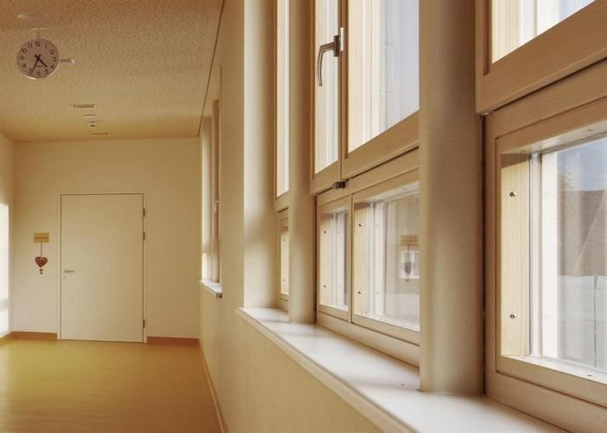
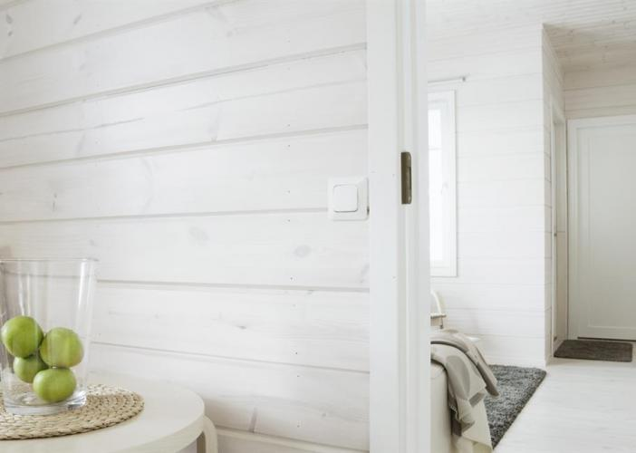
WINDOWS AND DOORS
WINDOW COMPONENTS
We offer a wide range of window components with quality being the key factor. By providing tailored solutions for the customers we can help their window manufacturing processes to be more efficient.
DOOR FRAME AND COMPONENTS
We offer finger-jointed wood component solutions for door and door frame manufacturers. Door rims (stiles & rails) are ready for assembly products, while door frame components are meant for door frame manufacturers.

Slide 9
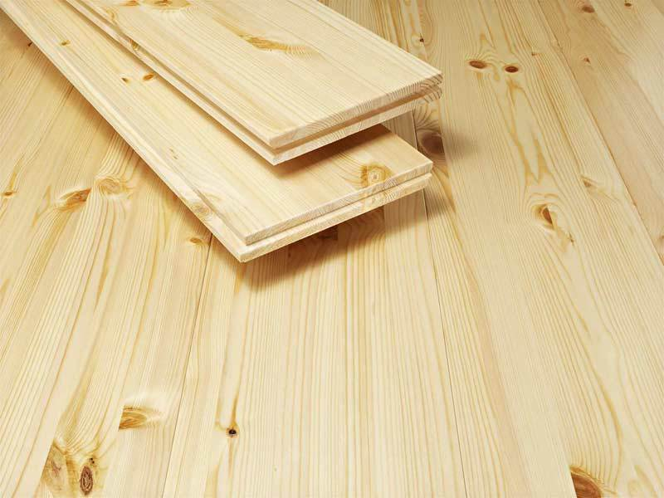
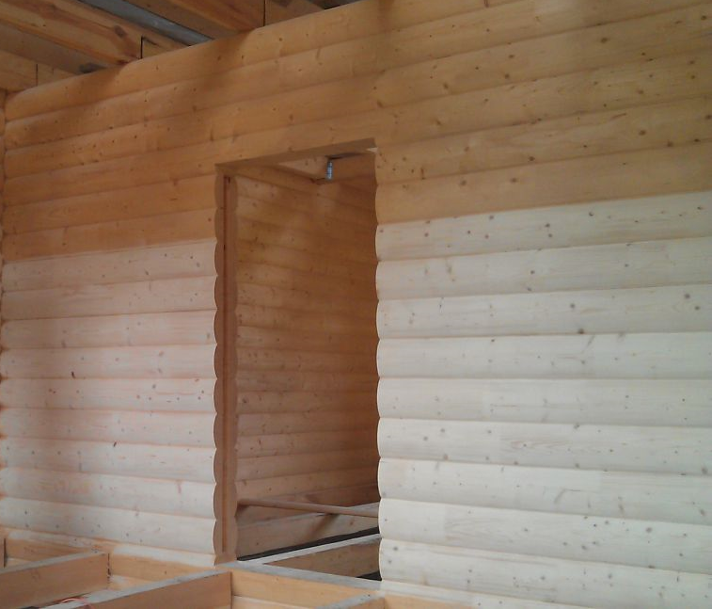
WOOD INTERIORS
FLOORING SYSTEMS
Wood is used in interiors as a surface material for walls, ceilings and floors, furniture, stairs, windows and doors, in features and decorations, etc. The use of wood extends from small private facilities to large public social and official premises.
Very often, wood is used because of the way it looks. The different colours and structures of types of wood and the different interior products made of wood such as panels, veneers, plywood and glued laminated boards enable the use of wood in countless different ways. In addition to whitewood, redwood and birch, other types of wood are also used in interiors.
The use of wood is also attractive because of its ease of use. Wood products are handy in terms of their size and light to transport, simple to put up and no special expertise or tools are needed to work with them. Ready surface-treated products and complete interior systems make the use of wood easier than ever. If desired, wood can be carved, milled or lathed into very intricate interior elements.
WALL PANEL SYSTEM

Slide 10
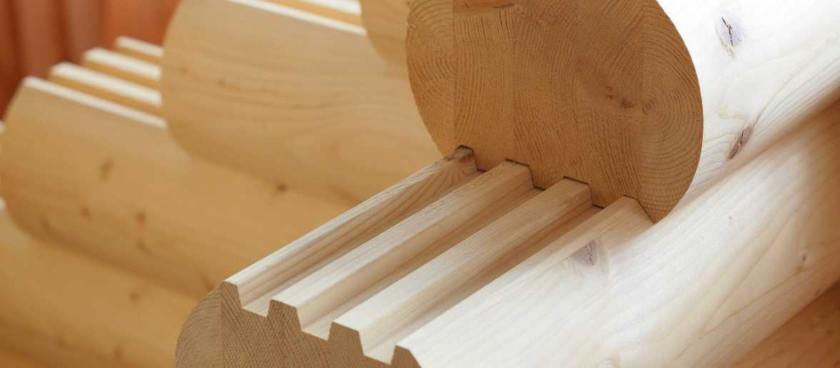
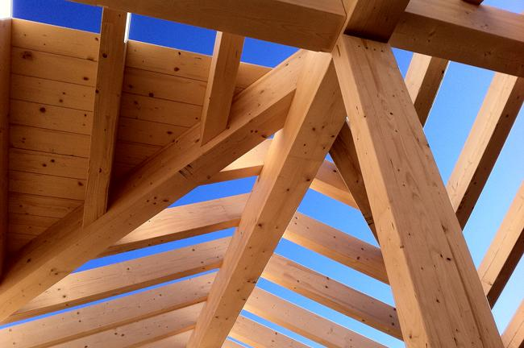
ENGINEERING WOOD
GLUED LAMINATED LUMBER
Wood products are suited to almost all new-build and renovation construction. Wood structures can be used in different applications in buildings, be they tall tower blocks, large halls or bridges. In addition to structures, common uses for wood products are windows and doors, interior decoration and furniture. Building standards regulating the use of wood vary from country to country.
There are many industrial alternatives for the construction of wooden buildings, from which the optimal solution for a specific case can be chosen. Common to them are highly developed industrial prefabrication and fast construction. A wooden building can be built in half the time required for traditional construction.
CEILING JOIST

Slide 11
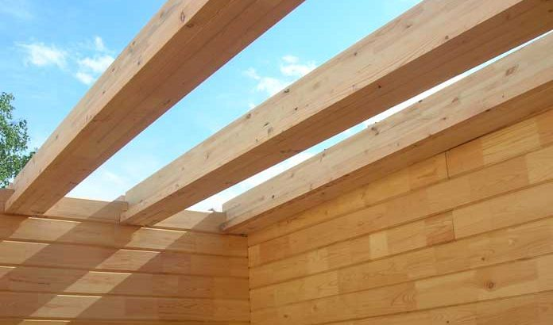
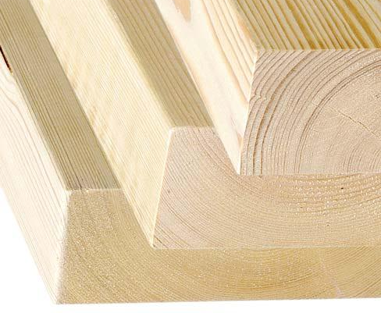
WOOD CONSTRUCTION
STRUCTUAL BEAM
BUILDING PRODUCTS

Slide 12
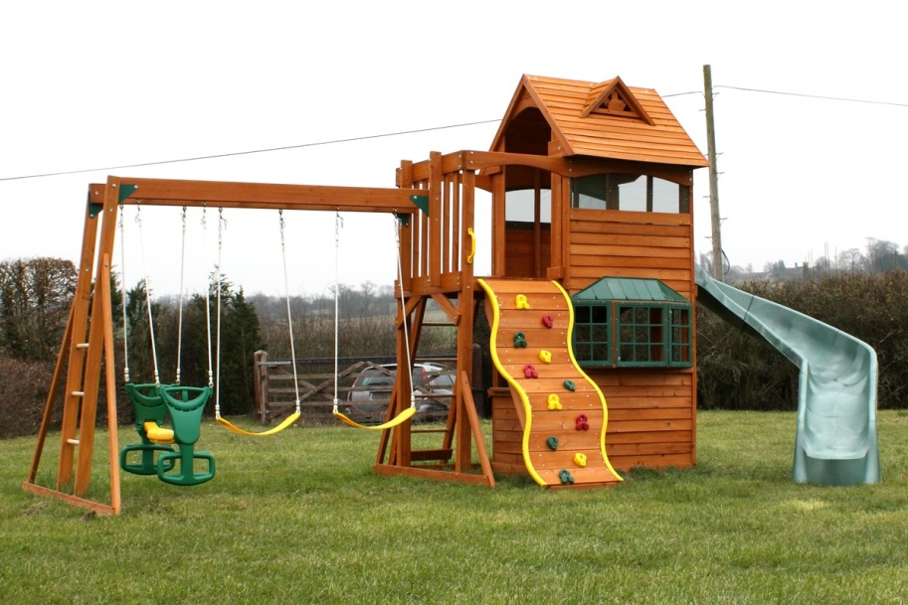
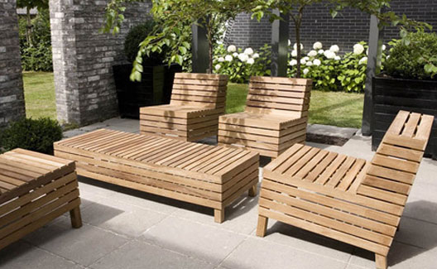
GARDEN AND OUTDOOR
PLAYGROUND
Wood is an ideal material for the outdoor and yard constructions. It is popular material for terraces, piers and other outdoor structures. In recent years, alongside the traditional wood-based materials there has become a whole bunch of new wood-based products.
Wood is easy to work with, it's a warm, natural and pleasant to touch. Structures and products made from wood can be easily renovated afterwards.
Outside wood is exposed to moisture and the sun, particularly ultraviolet radiation. Foundation structures are in contact with earth and concrete. Therefore, it is important to select the correct wood material for the right place.
Properly surface treated standard timber is also suitable for garden and yard constructions, especially for covered conditions and locations where structures can dry out without hindrance. If the structure is constantly exposed to the elements, particularly uncovered structures, such as the open terrace, you might want to use pressure-treated or heat-treated lumber.
OUTDOOR

Slide 13
THANK YOU!

